Slide 1

Chapter 7
Wireless and
Mobile Networks
A note on the use of these Powerpoint slides:
We’re making these slides freely available to all (faculty, students, readers). They’re in PowerPoint form so you see the animations; and can add, modify, and delete slides (including this one) and slide content to suit your needs. They obviously represent a lot of work on our part. In return for use, we only ask the following:
Computer Networking: A Top Down Approach
If you use these slides (e.g., in a class) that you mention their source (after all, we’d like people to use our book!)
If you post any slides on a www site, that you note that they are adapted from (or perhaps identical to) our slides, and note our copyright of this material.
Thanks and enjoy! JFK/KWR
All material copyright 1996-2016
J.F Kurose and K.W. Ross, All Rights Reserved
7th edition
Jim Kurose, Keith Ross
Pearson/Addison Wesley
April 2016

Slide 2
Ch. 6: Wireless and Mobile Networks
Background:
# wireless (mobile) phone subscribers now exceeds # wired phone subscribers (10-to-1 2019)!
# wireless Internet-connected devices equals # wireline Internet-connected devices
  laptops, Internet-enabled phones promise anytime untethered Internet access
more mobile-broadband-connected devices than fixed-broadband-connected devices (5-1 in 2019)!
  4G/5G cellular networks now embracing Internet protocol stack, including SDN
two important (but different) challenges
  wireless: communication over wireless link
  mobility: handling the mobile user who changes point of attachment to network

Slide 3

Chapter 7 outline
7.1 Introduction
Wireless
7.2 Wireless links, characteristics
  CDMA
7.3 IEEE 802.11 wireless LANs (“Wi-Fi”)
7.4 Cellular Internet Access
  architecture
  standards (e.g., 3G, LTE, 4G and 5G)
Mobility
7.5 Principles: addressing and routing to mobile users
7.6 Mobile IP
7.7 Handling mobility in cellular networks
7.8 Mobility and higher-layer protocols

Slide 4




Elements of a wireless network
network
infrastructure

Slide 5


Elements of a wireless network
wireless hosts
laptop, smartphone, IoT
run applications
may be stationary (non-mobile) or mobile
  wireless does not always mean mobility
network
infrastructure

Slide 6

Elements of a wireless network
base station
typically connected to wired network
relay - responsible for sending packets between wired network and wireless host(s) in its “area”
  e.g., cell towers, 802.11 access points
network
infrastructure

Slide 7
Elements of a wireless network
wireless link
typically used to connect mobile(s) to base station
also used as backbone link
multiple access protocol coordinates link access
various data rates, transmission distance and frequency bands
network
infrastructure

Slide 8
Characteristics of selected wireless links
1300
802.11 ac
450
802.11n
54
802.11a,g
802.11a,g point-to-point
5-11
802.11b
4G: LTWE WIMAX
4
3G: UMTS/WCDMA-HSPDA, CDMA2000-1xEVDO
Data rate (Mbps)
1
802.15
.384
2.5G: UMTS/WCDMA, CDMA2000
.056
2G: IS-95, CDMA, GSM
Indoor
10-30m
Outdoor
50-200m
Mid-range
outdoor
200m – 4 Km
Long-range
outdoor
5Km – 20 Km

Slide 9
Characteristics of selected wireless links
14 Gbps
802.11ax
10 Gbps
5G
3.5 Gbps
802.11ac
802.11 af,ah
600 Mbps
802.11n
4G LTE
54 Mbps
802.11g
11 Mbps
802.11b
2 Mbps
Bluetooth
Indoor
Outdoor
Midrange
outdoor
Long range
outdoor
10-30m
50-200m
200m-4Km
4Km-15Km

Slide 10
Elements of a wireless network
infrastructure mode
base station connects mobiles into wired network
handoff: mobile changes base station providing connection into wired network
network
infrastructure

Slide 11
Elements of a wireless network
ad hoc mode
no base stations
nodes can only transmit to other nodes within link coverage
nodes organize themselves into a network: route among themselves

Slide 12
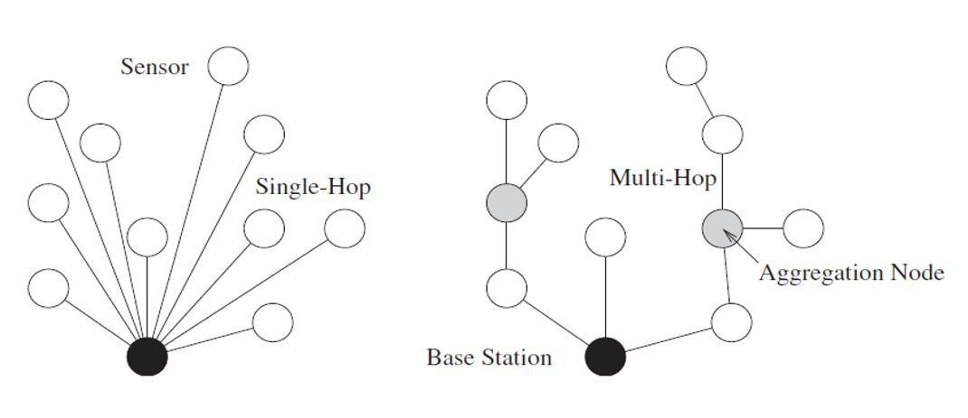
Extra Slide
Single Hop vs. Multiple Hop

Slide 13
Wireless network taxonomy
single hop
multiple hops
host connects to
base station (WiFi,
WiMAX, cellular)
which connects to
larger Internet
host may have to
relay through several
wireless nodes to
connect to larger
Internet: mesh net
infrastructure
(e.g., APs)
no base station, no
connection to larger
Internet. May have to
relay to reach other
a given wireless node
MANET, VANET
no
infrastructure
no base station, no
connection to larger
Internet (Bluetooth,
ad hoc nets)

Slide 14
Chapter 7 outline
7.1 Introduction
Wireless
7.2 Wireless links, characteristics
  CDMA
7.3 IEEE 802.11 wireless LANs (“Wi-Fi”)
7.4 Cellular Internet Access
  architecture
  standards (e.g., 3G, LTE, 4G and 5G )
Mobility
7.5 Principles: addressing and routing to mobile users
7.6 Mobile IP
7.7 Handling mobility in cellular networks
7.8 Mobility and higher-layer protocols

Slide 15
Wireless Link Characteristics (1)
important differences from wired link ….
  decreased signal strength: radio signal attenuates as it propagates through matter (path loss)
  interference from other sources: standardized wireless network frequencies (e.g., 2.4 GHz) shared by many (e.g., WiFi, cellular, motors): interference
  multipath propagation: radio signal reflects off objects ground, arriving to the destination at slightly different times
…. make communication across (even a point to point) wireless link much more “difficult”

Slide 16
Wireless Link Characteristics (2)
SNR: signal-to-noise ratio
  larger SNR – easier to extract signal from noise (a “good thing”)
SNR versus BER tradeoffs
  given physical layer: increase power -> increase SNR->decrease BER
  given SNR: choose physical layer that meets BER requirement, giving highest thruput
    SNR may change with mobility: dynamically adapt physical layer (modulation technique, rate)
10⁻¹
10⁻²
10⁻³
BER
10⁻⁴
10⁻⁵
10⁻⁶
10⁻⁷
10
20
30
40
SNR(dB)
QAM256 (8 Mbps)
QAM16 (4 Mbps)
BPSK (1 Mbps)

Slide 17


Wireless network characteristics
Multiple wireless senders and receivers create additional problems (beyond multiple access):
A
B
C
C
A’s signal
strength
C’s signal
strength
B
A
Hidden terminal problem
B, A hear each other
B, C hear each other
A, C can not hear each other means A, C unaware of their interference at B
space
Signal attenuation:
B, A hear each other
B, C hear each other
A, C can not hear each other interfering at B

Slide 18
Code Division Multiple Access (CDMA)
unique “code” assigned to each user; i.e., code set partitioning
  all users share same frequency, but each user has own “chipping” sequence (i.e., code) to encode data
  allows multiple users to “coexist” and transmit simultaneously with minimal interference (if codes are “orthogonal”)
encoded signal = (original data) X (chipping sequence)
decoding: inner-product of encoded signal and chipping sequence

Slide 19
CDMA encode/decode
channel output Z_{i,m}
Z_{i,m}= d_{i}.c_{m}
data
bits
d₀ = 1
1
1
1
1
1
d₁ = -1
1
1
1
-
-
-
-
1
-
-
-
1
-
1
1
1
1
1
sender
1
1
slot 1
channel
output
slot 0
channel
output
1
1
1
1
1
code
1
1
-
-
-
1
-
1
1
1
-
-
-
1
-
1
1
1
slot 1
slot 0
M
D_{i} = Σ Z_{i,m}.c_{m}
m=1
M
received
input
1
1
1
1
1
1
1
1
d₀ = 1
-
-
-
-
1
-
-
-
1
-
1
1
1
1
1
1
d₁ = -1
1
slot 1
channel
output
slot 0
channel
output
1
1
1
1
1
code
1
1
-
-
-
1
-
1
1
1
-
-
-
1
-
1
1
1
receiver
slot 1
slot 0

Slide 20
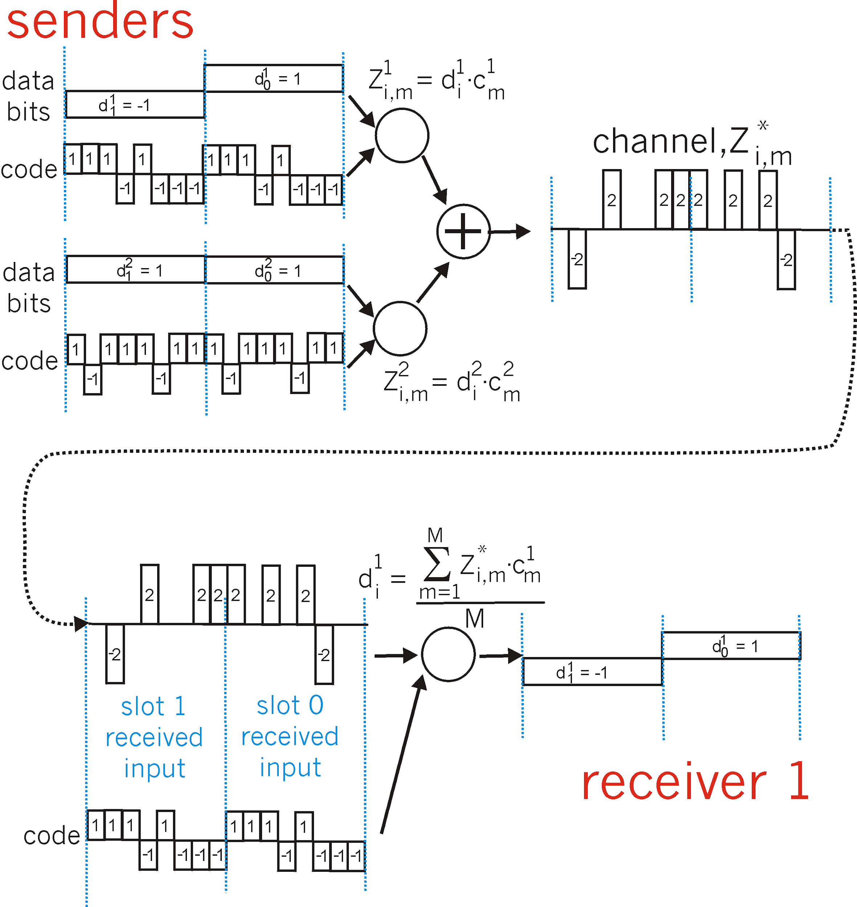
CDMA: two-sender interference
channel sums together transmissions by sender 1 and 2
Sender 1
Sender 2
using same code as sender 1, receiver recovers sender 1’s original data from summed channel data!

Slide 21
Chapter 7 outline
7.1 Introduction
Wireless
7.2 Wireless links, characteristics
  CDMA
7.3 IEEE 802.11 wireless LANs (“Wi-Fi”)
7.4 Cellular Internet Access
  architecture
  standards (e.g., 3G, LTE, 4G and 5G)
Mobility
7.5 Principles: addressing and routing to mobile users
7.6 Mobile IP
7.7 Handling mobility in cellular networks
7.8 Mobility and higher-layer protocols

Slide 22
IEEE 802.11 Wireless LAN
IEEE 802.11 standard | Year | Max data rate | Range | Frequency
802.11b | 1999 | 11 Mbps | 30 m | 2.4 Ghz
802.11g | 2003 | 54 Mbps | 30m | 2.4 Ghz
802.11n (WiFi 4) | 2009 | 600 | 70m | 2.4, 5 Ghz
802.11ac (WiFi 5) | 2013 | 3.47Gpbs | 70m | 5 Ghz
802.11ax (WiFi 6) | 2020 (exp.) | 14 Gbps | 70m | 2.4, 5 Ghz
802.11af | 2014 | 35 – 560 Mbps | 1 Km | unused TV bands (54-790 MHz)
802.11ah | 2017 | 347Mbps | 1 Km | 900 Mhz
all use CSMA/CA for multiple access, and have base-station and ad-hoc network versions

Slide 23



802.11 LAN architecture
wireless host communicates with base station
  base station = access point (AP)
Basic Service Set (BSS) (aka “cell”) in infrastructure mode contains:
  wireless hosts
  access point (AP): base station
  ad hoc mode: hosts only
Internet
hub, switch
or router
BSS 1
BSS 2

Slide 24
802.11: Channels, association
802.11b: 2.4GHz-2.485GHz spectrum divided into 11 channels at different frequencies
  AP admin chooses frequency for AP
  interference possible: channel can be same as that chosen by neighboring AP!
host: must associate with an AP
  scans channels, listening for beacon frames containing AP’s name (SSID) and MAC address
  selects AP to associate with
  may perform authentication [Chapter 8]
  will typically run DHCP to get IP address in AP’s subnet

Slide 25




802.11: passive/active scanning
BBS 1
BBS 2
BBS 1
BBS 2
1
AP 2
AP 1
1
1
AP 2
AP 1
2
2
2
3
3
4
H1
H1
passive scanning:
beacon frames sent from APs
association Request frame sent: H1 to selected AP
association Response frame sent from selected AP to H1
active scanning:
Probe Request frame broadcast from H1
Probe Response frames sent from APs
Association Request frame sent: H1 to selected AP
Association Response frame sent from selected AP to H1

Slide 26



IEEE 802.11: multiple access
avoid collisions: 2⁺ nodes transmitting at same time
802.11: CSMA - sense before transmitting
  don’t collide with ongoing transmission by other node
802.11: no collision detection!
  difficult to receive (sense collisions) when transmitting due to weak received signals (fading)
  can’t sense all collisions in any case: hidden terminal, fading
  goal: avoid collisions: CSMA/C(ollision)A(voidance)
A
B
C
C
B
A’s signal
strength
C’s signal
strength
A
space

Slide 27
IEEE 802.11 MAC Protocol: CSMA/CA
802.11 sender
1 if sense channel idle for DIFS then
  transmit entire frame (no CD)
2 if sense channel busy then
  start random backoff time
  timer counts down while channel idle
  transmit when timer expires
  if no ACK, increase random backoff interval, repeat 2
802.11 receiver
- if frame received OK
return ACK after SIFS (ACK needed due to hidden terminal problem)
sender
receiver
DIFS
data
SIFS
ACK

Slide 28
Avoiding collisions (more)
idea: allow sender to “reserve” channel rather than random access of data frames: avoid collisions of long data frames
sender first transmits small request-to-send (RTS) packets to BS using CSMA
  RTSs may still collide with each other (but they’re short)
BS broadcasts clear-to-send CTS in response to RTS
CTS heard by all nodes
  sender transmits data frame
  other stations defer transmissions
avoid data frame collisions completely
using small reservation packets!

Slide 29


Collision Avoidance: RTS-CTS exchange
A
B
AP
RTS(B)
RTS(A)
reservation collision
RTS(A)
CTS(A)
CTS(A)
DATA (A)
defer
time
ACK(A)
ACK(A)

Slide 30
802.11 frame: addressing
2
2
6
6
6
2
6
0 - 2312
4
frame
control
duration
address
1
address
2
address
3
seq
control
address
4
payload
CRC
Address 4: used only in ad hoc mode
Address 1: MAC address
of wireless host or AP
to receive this frame
Address 3: MAC address
of router interface to which AP is attached
Address 2: MAC address
of wireless host or AP
transmitting this frame

Slide 31

802.11 frame: addressing
Internet
H1
R1
router
R1 MAC addr H1 MAC addr
dest. address
source address
802.3 Ethernet frame
AP MAC addr H1 MAC addr R1 MAC addr
address 1
address 2
address 3
802.11 frame

Slide 32
802.11 frame: more
frame seq #
(for RDT)
duration of reserved
transmission time (RTS/CTS)
2
2
6
6
6
2
6
0 - 2312
4
frame
control
duration
address
1
address
2
address
3
seq
control
address
4
payload
CRC
2
2
4
1
1
1
1
1
1
1
1
Protocol
version
Type
Subtype
To
AP
From
AP
More
frag
Retry
Power
mgt
More
data
WEP
Rsvd
frame type
(RTS, CTS, ACK, data)

Slide 33

802.11: mobility within same subnet
H1 remains in same IP subnet: IP address can remain same
switch: which AP is associated with H1?
  self-learning (Ch. 5): switch will see frame from H1 and “remember” which switch port can be used to reach H1
BBS 1
H1
BBS 2

Slide 34
802.11: advanced capabilities
Rate adaptation
base station, mobile dynamically change transmission rate (physical layer modulation technique) as mobile moves, SNR varies
10⁻¹
10⁻²
10⁻³
BER
10⁻⁴
10⁻⁵
10⁻⁶
10⁻⁷
10
20
30
40
SNR(dB)
1. SNR decreases, BER increase as node moves away from base station
QAM256 (8 Mbps)
QAM16 (4 Mbps)
2. When BER becomes too high, switch to lower transmission rate but with lower BER
BPSK (1 Mbps)
operating point

Slide 35
802.11: advanced capabilities
power management
node-to-AP: “I am going to sleep until next beacon frame”
  AP knows not to transmit frames to this node
  node wakes up before next beacon frame
beacon frame: contains list of mobiles with AP-to-mobile frames waiting to be sent
  node will stay awake if AP-to-mobile frames to be sent; otherwise sleep again until next beacon frame

Slide 36
802.15: personal area network (Bluetooth)
less than 10 m diameter
replacement for cables (mouse, keyboard, headphones)
ad hoc: no infrastructure
master/slaves:
  slaves request permission to send (to master)
  master grants requests
802.15: evolved from Bluetooth specification
  2.4-2.5 GHz radio band
  up to 3 Mbps
S
P
P
radius of
coverage
M
S
S
P
P
M
Master device
Slave device
Parked device (inactive)
S
P

Slide 37
Chapter 7 outline
7.1 Introduction
Wireless
7.2 Wireless links, characteristics
  CDMA
7.3 IEEE 802.11 wireless LANs (“Wi-Fi”)
7.4 Cellular Internet access
  architecture
  standards (e.g., 3G, LTE, 4G and 5G)
Mobility
7.5 Principles: addressing and routing to mobile users
7.6 Mobile IP
7.7 Handling mobility in cellular networks
7.8 Mobility and higher-layer protocols

Slide 38


Components of cellular network architecture
MSC
connects cells to wired tel. net.
manages call setup (more later!)
handles mobility (more later!)
cell
covers geographical region
base station (BS) analogous to 802.11 AP
mobile users attach to network through BS
air-interface: physical and link layer protocol between mobile and BS
Mobile
Switching
Center
Public telephone
network
Mobile
Switching
Center
wired network

Slide 39

Cellular networks: the first hop
Two techniques for sharing mobile-to-BS radio spectrum
combined FDMA/TDMA: divide spectrum in frequency channels, divide each channel into time slots
CDMA: code division multiple access
time slots
frequency
bands

Slide 40
2G (voice) network architecture
Base station system (BSS)
MSC
BTS
BSC
G
Public
telephone
network
Gateway
MSC
Legend
Base transceiver station (BTS)
Base station controller (BSC)
Mobile Switching Center (MSC)
Mobile subscribers

Slide 41
3G (voice+data) network architecture
MSC
G
Public
telephone
network
radio
network
controller
Gateway
MSC
G
Public
Internet
SGSN
Key insight: new cellular data
network operates in parallel
(except at edge) with existing
cellular voice network
voice network unchanged in core
data network operates in parallel
GGSN
Serving GPRS Support Node (SGSN)
Gateway GPRS Support Node (GGSN)

Slide 42
3G (voice+data) network architecture
MSC
G
Public
telephone
network
radio
network
controller
Gateway
MSC
G
Public
Internet
SGSN
GGSN
radio interface
(WCDMA, HSPA)
radio access network
Universal Terrestrial Radio
Access Network (UTRAN)
core network
General Packet Radio Service
(GPRS) Core Network
public
Internet

Slide 43
3G versus 4G LTE network architecture
MSC
G
Public
telephone
network
3G
radio
network
controller
Gateway
MSC
G
Public
Internet
SGSN
GGSN
4G-LTE
HSS
MME
G
G
Public
Internet
S-GW
P-GW
radio access network
Universal Terrestrial Radio
Access Network (UTRAN)
Evolved Packet Core
(EPC)

Slide 44
4G: differences from 3G
all IP core: IP packets tunneled (through core IP network) from base station to gateway
no separation between voice and data – all traffic carried over IP core to gateway
Mobility
Management
Entity (MME)
Home Subscriber
Server(HSS)
(like HLR+VLR)
Serving
Gateway
(S-GW)
Packet data
network
Gateway
(P-GW)
UE
(user element)
eNodeB
(base station)
HSS
MME
control
G
G
Public
Internet
data
S-GW
P-GW
radio access network
Universal Terrestrial Radio
Access Network (UTRAN)
Evolved Packet Core
(EPC)

Slide 45

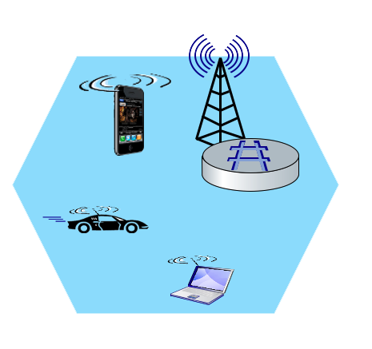
Elements of 4G LTE architecture
Extra Slide
Mobile device:
smartphone, tablet, laptop, IoT, ... with 4G LTE radio
64-bit International Mobile Subscriber Identity (IMSI), stored on SIM (Subscriber Identity Module) card
LTE jargon: User Equipment (UE)
Mobility Management Entity (MME)
Home Subscriber Service (HSS)
Mobile device
(UE)
Base station
(eNode-B)
to
Internet
PDN gateway (P-GW)
…
Serving Gateway (S-GW)
radio access
network
all-IP Enhanced Packet Core (EPC)

Slide 46
Elements of 4G LTE architecture
Extra Slide
Base station:
at “edge” of carrier’s network
manages wireless radio resources, mobile devices in its coverage area (“cell”)
coordinates device authentication with other elements
similar to WiFi AP but:
  active role in user mobility
  coordinates with nearly base stations to optimize radio use
LTE jargon: eNode-B
Mobility Management Entity (MME)
Home Subscriber Service (HSS)
Mobile device
(UE)
Base station
(eNode-B)
to
Internet
PDN gateway (P-GW)
…
Serving Gateway (S-GW)

Slide 47
Elements of 4G LTE architecture
Extra Slide
Home Subscriber Service
stores info about mobile devices for which the HSS’s network is their “home network”
works with MME in device authentication
Mobility Management Entity (MME)
Home Subscriber Service (HSS)
Mobile device
(UE)
Base station
(eNode-B)
to
Internet
PDN gateway (P-GW)
…
Serving Gateway (S-GW)

Slide 48
Elements of 4G LTE architecture
Extra Slide
Serving Gateway (S-GW), PDN Gateway (P-GW)
lie on data path from mobile to/from Internet
P-GW
  gateway to mobile cellular network
  Looks like nay other internet gateway router
  provides NAT services
other routers:
  extensive use of tunneling
Mobility Management Entity (MME)
Home Subscriber Service (HSS)
Mobile device
(UE)
Base station
(eNode-B)
to
Internet
PDN gateway (P-GW)
…
Serving Gateway (S-GW)

Slide 49
Elements of 4G LTE architecture
Extra Slide
Mobility Management Entity
device authentication (device-to-network, network-to-device) coordinated with mobile home network HSS
Mobility Management Entity (MME)
Home Subscriber Service (HSS)
Mobile device
(UE)
Base station
(eNode-B)
to
Internet
PDN gateway (P-GW)
mobile device management:
  device handover between cells
  tracking/paging device location
path (tunneling) setup from mobile device to P-GW
…
Serving Gateway (S-GW)

Slide 50
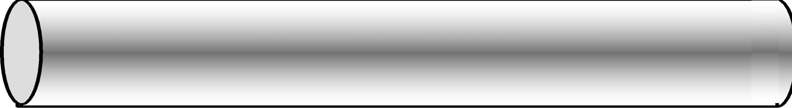
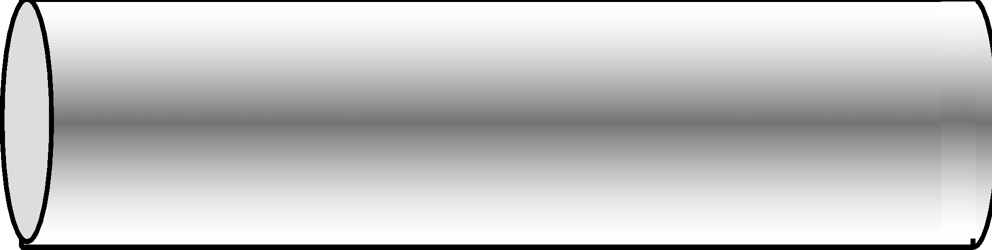
LTE: data plane control plane separation
Extra Slide
HSS
control plane
new protocols for mobility management , security, authentication (later)
base station
P-GW
MME
S-GW
data plane
new protocols at link, physical layers
base station
S-GW
P-GW
extensive use of tunneling to facilitate mobility
IP tunnels

Slide 51
LTE data plane protocol stack: first hop
Extra Slide
LTE link layer protocols:
Packet Data Convergence: header compression, encryption
Radio Link Control (RLC) Protocol: fragmentation/reassembly, reliable data transfer
Medium Access: requesting, use of radio transmission slots
Application
Transport
IP
IP
Packet Data
Convergence
Packet Data
Convergence
Link
Radio Link
Radio Link
Medium Access
Medium Access
Physical
Physical
data
plane
base station
S-GW
P-GW

Slide 52
LTE data plane protocol stack: first hop
Extra Slide
LTE radio access network:
downstream channel: FDM, TDM within frequency channel (OFDM - orthogonal frequency division multiplexing)
  “orthogonal”: minimal interference between channels
  upstream: FDM, TDM similar to OFDM
each active mobile device allocated two or more 0.5 ms time slots over 12 frequencies
  scheduling algorithm not standardized – up to operator
  100’s Mbps per device possible
Application
Transport
IP
IP
Packet Data
Convergence
Packet Data
Convergence
Link
Radio Link
Radio Link
Medium Access
Medium Access
Physical
Physical
base station

Slide 53

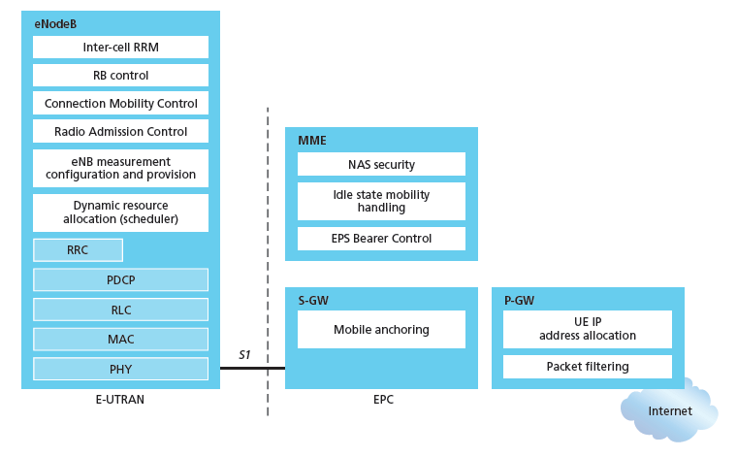
Functional split of major LTE components
handles idle/active UE transitions
pages UE
sets up eNodeB-PGW tunnel (aka bearer)
holds idle UE info
QoS enforcement

Slide 54
LTE data plane protocol stack: packet core
Extra Slide
tunneling:
mobile datagram encapsulated using GPRS Tunneling Protocol (GTP), sent inside UDP datagram to S-GW
S-GW re-tunnels datagrams to P-GW
supporting mobility: only tunneling endpoints change when mobile user moves
GTP-U
GTP-U
GTP-U
UDP
UDP
UDP
IP
IP
IP
IP
Packet Data
Convergence
Radio Link
link
link
link
Medium Access
Physical
Physical
Physical
Physical
\
base station
S-GW
P-GW

Slide 55

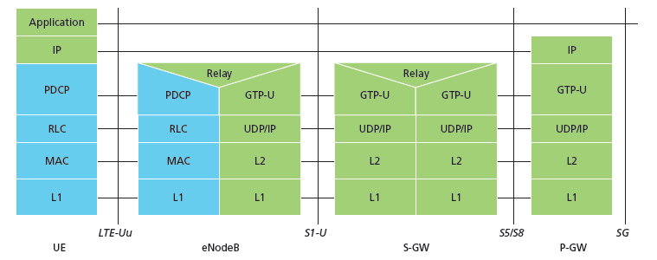
Radio+Tunneling: UE – eNodeB – PGW
IP packet from UE encapsulated in GPRS Tunneling Protocol (GTP) message at ENodeB
GTP message encapsulated in UDP, then encapsulated in IP. large IP packet addressed to SGW
G
G
UE
eNodeB
S-GW
P-GW
tunnel
link-layer radio net

Slide 56
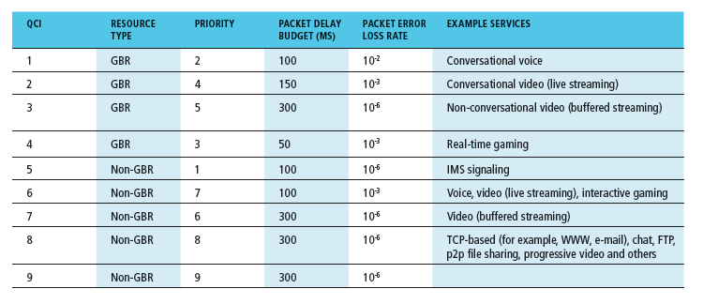
Quality of Service in LTE
QoS from eNodeB to SGW: min and max guaranteed bit rate
QoS in radio access network: one of 12 QCI values

Slide 57
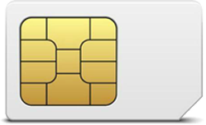
Global cellular network: a network of IP networks
Extra Slide
home network HSS:
identify & services info, while in home network and roaming
Home
Subscriber
Server
home mobile
carrier network
P-GW
public Internet
and
inter-carrier IPX
all IP:
carriers interconnect with each other, and public internet at exchange points
legacy 2G, 3G: not all IP, handled otherwise
…
…
in home network
P-GW
SIM card: global identify info in home network
visited mobile
carrier network
…
roaming in visited network

Slide 58
On to 5G!
Extra Slide
goal: 10x increase in peak bitrate, 10x decrease in latency, 100x increase in traffic capacity over 4G
5G NR (new radio):
  two frequency bands: FR1 (450 MHz–6 GHz) and FR2 (24 GHz–52 GHz): millimeter wave frequencies
  not backwards-compatible with 4G
  MIMO: multiple directional antennae
millimeter wave frequencies: much higher data rates, but over shorter distances
  pico-cells: cells diameters: 10-100 m
  massive, dense deployment of new base stations required

Slide 59
4G/5G cellular networks
Extra Slide
similarities to wired Internet
edge/core distinction, but both below to same carrier
global cellular network: a network of networks
widespread use of protocols we’ve studied: HTTP, DNS, TCP, UDP, IP, NAT, separation of data/control planes, SDN, Ethernet, tunneling
interconnected to wired Internet
differences from wired Internet
different wireless link layer
mobility as a 1st class service
user “identity” (via SIM card)
business model: users subscribe to a cellular provider
  strong notion of “home network” versus roaming on visited nets
  global access, with authentication infrastructure, and inter-carrier settlements

Slide 60
Chapter 7 outline
7.1 Introduction
Wireless
7.2 Wireless links, characteristics
  CDMA
7.3 IEEE 802.11 wireless LANs (“Wi-Fi”)
7.4 Cellular Internet Access
  architecture
  standards (e.g., 3G, LTE, 4G and 5G)
Mobility
7.5 Principles: addressing and routing to mobile users
7.6 Mobile IP
7.7 Handling mobility in cellular networks
7.8 Mobility and higher-layer protocols

Slide 61
What is mobility?
spectrum of mobility, from the network perspective:
no mobility
high mobility
device moves
between networks, but
powers down
while moving
device moves within same AP in
one provider
network
device moves among APs in
one provider
network
device moves
among multiple
provider networks,
while maintaining
ongoing connections
We’re interested in these!

Slide 62



Mobility: vocabulary
home network: permanent “home” of mobile
(e.g., 128.119.40/24)
home agent: entity that will perform mobility functions on behalf of mobile, when mobile is remote
wide area network
permanent address: address in home network, can always be used to reach mobile
e.g., 128.119.40.186

Slide 63
Mobility: more vocabulary
permanent address: remains constant (e.g., 128.119.40.186)
visited network: network in which mobile currently resides (e.g., 79.129.13/24)
care-of-address: address in visited network.
(e.g., 79,129.13.2)
wide area network
foreign agent: entity in visited network that performs mobility functions on behalf of mobile.
correspondent: wants to communicate with mobile

Slide 64

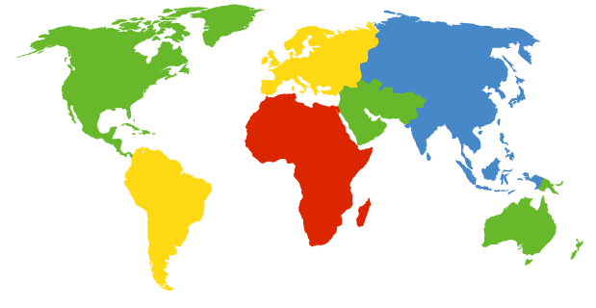

Contacting a mobile friend:
I wonder where Alice moved to?
Consider friend frequently changing locations, how do you find him/her?
search all phone books?
expect her to let you know where he/she is?
call his/her parents?
Facebook!
The importance of having a “home”:
a definitive source of information about you
a place where people can find out where you are

Slide 65
Mobility approaches
let network (routers) handle it:
  routers advertise well-known name, address (e.g., permanent 32-bit IP address), or number (e.g., cell #) of visiting mobile node via usual routing table exchange
  Internet routing could do this already with no changes! Routing tables indicate where each mobile located via longest prefix match!

Slide 66
Mobility approaches
let network (routers) handle it:
  routers advertise well-known name, address (e.g., permanent 32-bit IP address), or number (e.g., cell #) of visiting mobile node via usual routing table exchange
  Internet routing could do this already with no changes! Routing tables indicate where each mobile located via longest prefix match!
not
scalable
to billions of
mobiles
let end-systems handle it: functionality at the “edge”
  indirect routing: communication from correspondent to mobile goes through home network, then forwarded to remote mobile
  direct routing: correspondent gets foreign address of mobile, send directly to mobile

Slide 67
Mobility: registration
visited network
home network
1
2
wide area network
mobile contacts foreign agent on entering visited network
foreign agent contacts home agent home: “this mobile is resident in my network”
end result:
foreign agent knows about mobile
home agent knows location of mobile

Slide 68

Mobility via indirect routing
foreign agent receives packets, forwards to mobile
home agent intercepts packets, forwards to foreign agent
visited
network
home
network
3
wide area network
2
1
correspondent addresses packets using home address of mobile
4
mobile replies directly to correspondent

Slide 69
Indirect Routing: comments
mobile uses two addresses:
  permanent address: used by correspondent (hence mobile location is transparent to correspondent)
  care-of-address: used by home agent to forward datagrams to mobile
foreign agent functions may be done by mobile itself
triangle routing: correspondent-home-network-mobile
  inefficient when
  correspondent, mobile
  are in same network

Slide 70
Indirect routing: moving between networks
suppose mobile user moves to another network
  registers with new foreign agent
  new foreign agent registers with home agent
  home agent update care-of-address for mobile
  packets continue to be forwarded to mobile (but with new care-of-address)
mobility, changing foreign networks transparent: on going connections can be maintained!

Slide 71



Mobility via direct routing
foreign agent receives packets, forwards to mobile
correspondent forwards to foreign agent
visited
network
home
network
3
1
2
4
correspondent requests, receives foreign address of mobile
mobile replies directly to correspondent

Slide 72

Mobility via direct routing: comments
overcome triangle routing problem
non-transparent to correspondent: correspondent must get care-of-address from home agent
  what if mobile changes visited network?
3
1
2
4

Slide 73

Accommodating mobility with direct routing
anchor foreign agent: FA in first visited network
data always routed first to anchor FA
when mobile moves: new FA arranges to have data forwarded from old FA (chaining)
foreign net visited
at session start
anchor
foreign
agent
wide area network
2
1
4
5
3
new
foreign
network
correspondent
agent
new foreign
agent
correspondent

Slide 74
Chapter 7 outline
7.1 Introduction
Wireless
7.2 Wireless links, characteristics
  CDMA
7.3 IEEE 802.11 wireless LANs (“Wi-Fi”)
7.4 Cellular Internet Access
  architecture
  standards (e.g., 3G, LTE)
Mobility
7.5 Principles: addressing and routing to mobile users
7.6 Mobile IP
7.7 Handling mobility in cellular networks
7.8 Mobility and higher-layer protocols

Slide 75
Mobile IP
RFC 3344
has many features we’ve seen:
  home agents, foreign agents, foreign-agent registration, care-of-addresses, encapsulation (packet-within-a-packet)
three components to standard:
  indirect routing of datagrams
  agent discovery
  registration with home agent

Slide 76


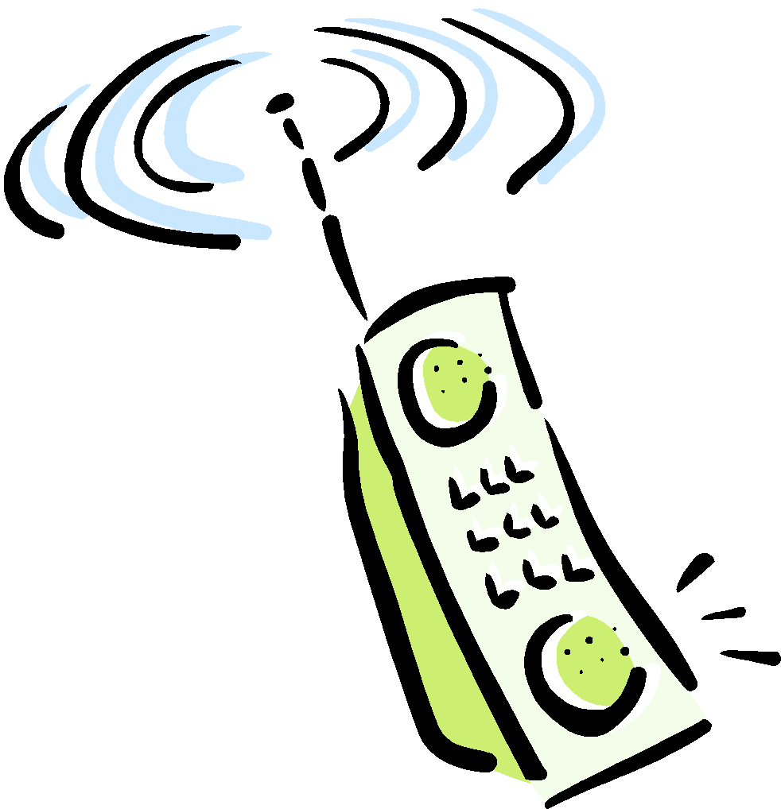
Mobile IP: indirect routing
foreign-agent-to-mobile packet
packet sent by home agent to foreign agent: a packet within a packet
dest: 128.119.40.186
dest: 79.129.13.2
dest: 128.119.40.186
Permanent address: 128.119.40.186
Care-of address: 79.129.13.2
dest: 128.119.40.186
packet sent by correspondent

Slide 77
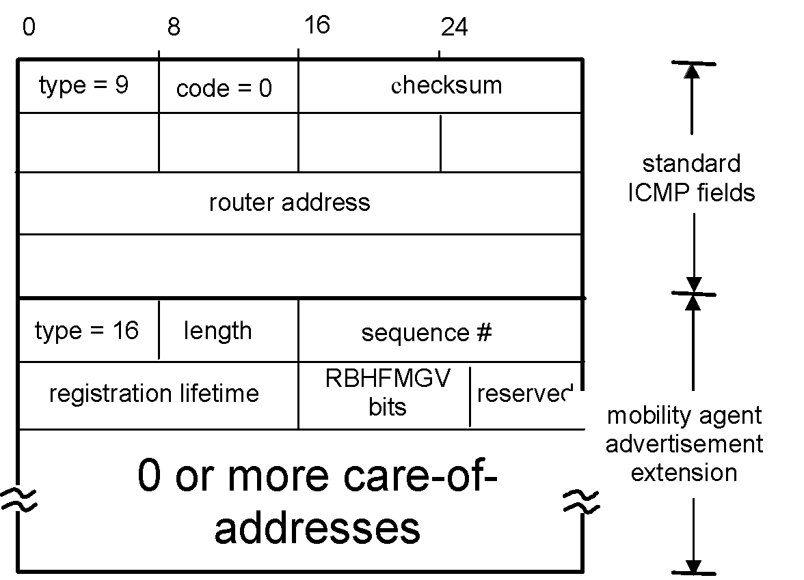
Mobile IP: agent discovery
agent advertisement: foreign/home agents advertise service by broadcasting ICMP messages (typefield = 9)
H,F bits: home and/or foreign agent
R bit: registration required

Slide 78


Mobile IP: registration example
visited network: 79.129.13/24
home agent
HA: 128.119.40.7
foreign agent
COA: 79.129.13.2
mobile agent
MA: 128.119.40.186
ICMP agent adv.
COA: 79.129.13.2
….
registration req.
registration req.
COA: 79.129.13.2
HA: 128.119.40.7
MA: 128.119.40.186
Lifetime: 9999
identification: 714
encapsulation format
….
COA: 79.129.13.2
HA: 128.119.40.7
MA: 128.119.40.186
Lifetime: 9999
identification:714
….
registration reply
HA: 128.119.40.7
MA: 128.119.40.186
Lifetime: 4999
Identification: 714
encapsulation format
….
registration reply
HA: 128.119.40.7
MA: 128.119.40.186
Lifetime: 4999
Identification: 714
….
time

Slide 79

Components of cellular network architecture
recall:
correspondent
wired public telephone
network
MSC
MSC
MSC
MSC
MSC
different cellular networks,
operated by different providers

Slide 80
Handling mobility in cellular networks
home network: network of cellular provider you subscribe to (e.g., Sprint PCS, Verizon)
  home location register (HLR): database in home network containing permanent cell phone #, profile information (services, preferences, billing), information about current location (could be in another network)
visited network: network in which mobile currently resides
  visitor location register (VLR): database with entry for each user currently in network
  could be home network

Slide 81


GSM: indirect routing to mobile
HLR
home
network
2
correspondent
home
Mobile
Switching
Center
home MSC consults HLR,
gets roaming number of
mobile in visited network
1
call routed
to home network
3
Public switched
telephone
network
VLR
Mobile
Switching
Center
4
home MSC sets up 2nd leg of call
to MSC in visited network
mobile
user
MSC in visited network completes
call through base station to mobile
visited
network

Slide 82
GSM: handoff with common MSC
handoff goal: route call via new base station (without interruption)
reasons for handoff:
  stronger signal to/from new BSS (continuing connectivity, less battery drain)
  load balance: free up channel in current BSS
  GSM doesn't mandate why to perform handoff (policy), only how (mechanism)
handoff initiated by old BSS
VLR
Mobile
Switching
Center
old
routing
new
routing
old BSS
new BSS

Slide 83
GSM: handoff with common MSC
1. old BSS informs MSC of impending handoff, provides list of 1⁺ new BSSs
2. MSC sets up path (allocates resources) to new BSS
3. new BSS allocates radio channel for use by mobile
4. new BSS signals MSC, old BSS: ready
5. old BSS tells mobile: perform handoff to new BSS
6. mobile, new BSS signal to activate new channel
7. mobile signals via new BSS to MSC: handoff complete. MSC reroutes call
8 MSC-old-BSS resources released
VLR
Mobile
Switching
Center
4
2
1
8
7
3
old BSS
5
6
new BSS

Slide 84
GSM: handoff between MSCs
anchor MSC: first MSC visited during call
  call remains routed through anchor MSC
new MSCs add on to end of MSC chain as mobile moves to new MSC
optional path minimization step to shorten multi-MSC chain
home network
correspondent
Home MSC
anchor MSC
PSTN
MSC
MSC
MSC
(a) before handoff

Slide 85
GSM: handoff between MSCs
anchor MSC: first MSC visited during call
  call remains routed through anchor MSC
new MSCs add on to end of MSC chain as mobile moves to new MSC
optional path minimization step to shorten multi-MSC chain
home network
correspondent
Home MSC
anchor MSC
PSTN
MSC
MSC
MSC
(b) after handoff

Slide 86
Mobility in 4G networks: major mobility tasks
Extra Slide
1
base station association:
covered earlier
mobile provides IMSI – identifying itself, home network
Mobility manager
Home
Subscriber
Server
2
1
MME
Home
network
3
base station
P-GW
S-GW
4
2
control-plane configuration:
MME, home HSS establish control-plane state - mobile is in visited network
Internet
P-GW
Visited network
Streaming server
3
data-plane configuration:
MME configures forwarding tunnels for mobile
visited, home network establish tunnels from home P-GW to mobile
4
mobile handover:
mobile device changes its point of attachment to visited network

Slide 87

Handling Mobility in LTE
Paging: idle UE may move from cell to cell: network does not know where the idle UE is resident
  paging message from MME broadcast by all eNodeB to locate UE
handoff: similar to 3G:
  preparation phase
  execution phase
  completion phase
source
MME
P-GW
target
MME
old
routing
new
routing
old
eNodeB
new
eNodeB

Slide 88
Mobility: cellular versus Mobile IP
cellular element |  | Comment on cellular element | Mobile IP element
Home system | Network to which mobile user’s permanent phone number belongs |  |  | Home network
Gateway Mobile Switching Center, or “home MSC”. Home Location Register (HLR) | Home MSC: point of contact to obtain routable address of mobile user. HLR: database in home system containing permanent phone number, profile information, current location of mobile user, subscription information |  |  | Home agent
Visited System | Network other than home system where mobile user is currently residing |  |  | Visited network
Visited Mobile services Switching Center. Visitor Location Record (VLR) | Visited MSC: responsible for setting up calls to/from mobile nodes in cells associated with MSC. VLR: temporary database entry in visited system, containing subscription information for each visiting mobile user |  |  | Foreign agent
Mobile Station Roaming Number (MSRN), or “roaming number” | Routable address for telephone call segment between home MSC and visited MSC, visible to neither the mobile nor the correspondent. |  |  | Care-of-address

Slide 89
Wireless, mobility: impact on higher layer protocols
logically, impact should be minimal …
  best effort service model remains unchanged
  TCP and UDP can (and do) run over wireless, mobile
… but performance-wise:
  packet loss/delay due to bit-errors (discarded packets, delays for link-layer retransmissions), and handoff
  TCP interprets loss as congestion, will decrease congestion window un-necessarily
  delay impairments for real-time traffic
  limited bandwidth of wireless links

Slide 90
Chapter 7 summary
Wireless
wireless links:
  capacity, distance
  channel impairments
  CDMA
IEEE 802.11 (“Wi-Fi”)
  CSMA/CA reflects wireless channel characteristics
cellular access
  architecture
  standards (e.g., 3G, LTE, 4G and 5G)
Mobility
principles: addressing, routing to mobile users
  home, visited networks
  direct, indirect routing
  care-of-addresses
case studies
  mobile IP
  mobility in GSM, LTE
impact on higher-layer protocols

